Slide 1
Analytical Exercise
Adeola Oladeji September 2023

Slide 2
Data Cleaning and Preprocessing
Before loading the CSV file, I repositioned ORDER_DATE as the first column and sorted it chronologically for efficient indexing
Removed the ROW column as it contained only row serial numbers.
Addressed missing data by eliminating minimal percentages (3% for 'FEATURE_2' and 1.32% for 'LOYALTY_SCORE') to ensure data integrity.
Date information was formatted and set as the dataset's index
Performed feature engineering related to sales data.
In this analysis, only the following features were utilized for prediction: Feature_1, Feature_2, and Feature_3. This choice was made due to the observation that a majority of the data in the dataset consists of categorical data, and for regression modeling, continuous data is required.

Slide 3
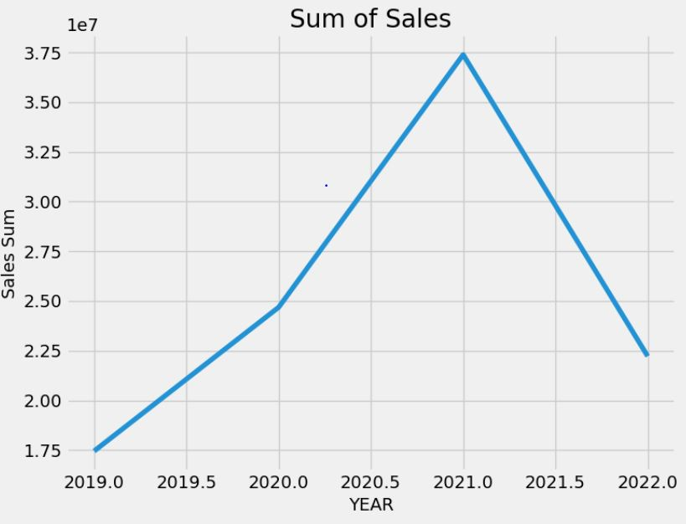
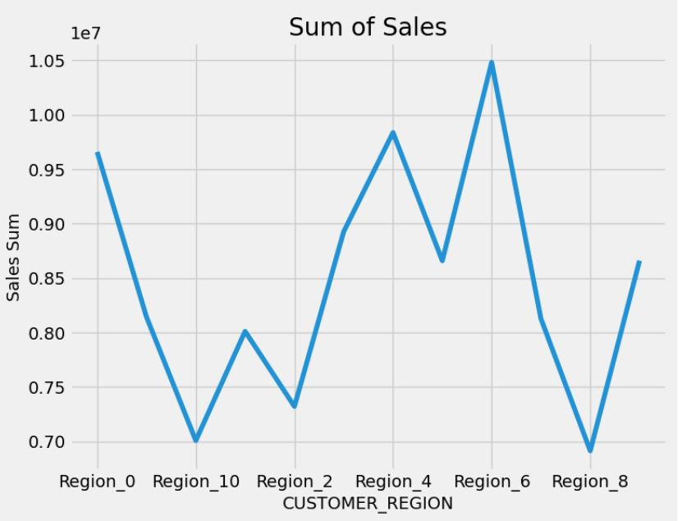
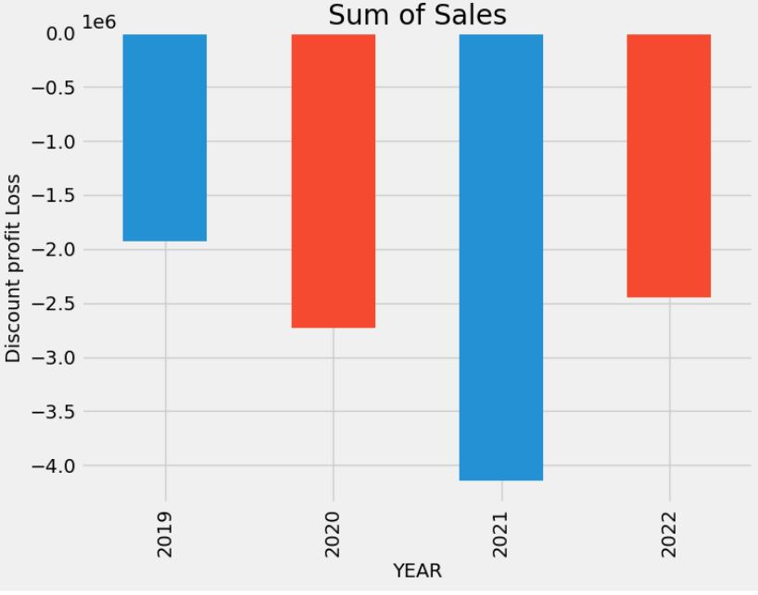
Data Exploration Analysis
Sales Trends: August had the highest sales, with a dip from April to July. The second quarter had the lowest sales.
Customer Loyalty: Regions 0, 11, 3, 4, 5, 6, 7, and 9 showed high levels of customer loyalty, with region 6 having the highest loyalty score.
Customer Base: Region 6 had the largest customer base, indicating its significance.
Unit Orders: Region 6 outperformed others in units ordered, while Region 8 had the lowest.
Yearly Sales: The highest sales was in 2021. Sales showed a positive trend from 2019 to 2021 but a significant downturn in 2022.
Product Analysis: The product 4 category had the highest diloss. August had the highest loss from discounted sales, and the first quarter had the most losses.
Seasonality: Most sales occurred in seasonality 1.
Product category: Product category 4 is the most unit ordered even with low product rating.
Product Ratings: Product 9 had the highest customer rating, while categories 2, 3, 4, and 5 had lower ratings.

Slide 4
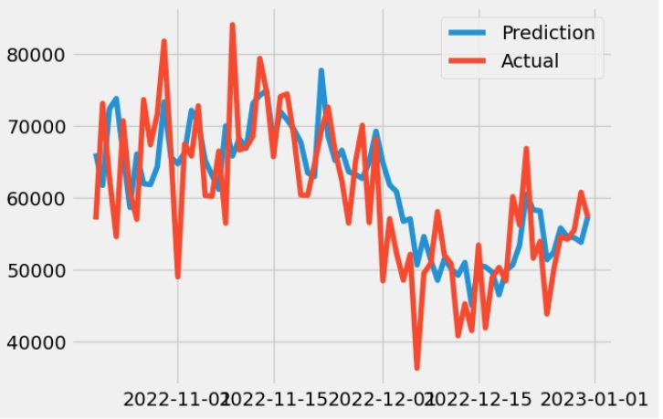
Model Development and Evaluation
I used regression models due to the target variable being sales (a continuous variable)
Based on the above analysis, I chose the Gradient Boosting Algorithm as the final model to predict the sales because it gives us the least RMSE and is well suited to our needs of predicting time series seasonal data.
Best Parameters:
Algorithm: GradientBoostingRegressor
Learning Rate: 0.01
Maximum Depth: 10
Number of Estimators: 1500
Subsample: 0.5
Models | Random Forest Algorithm | Gradient Boosting Algorithm | Support Vector Regressor | XGBOOST | ADA BOOST | LightGBM Regressor
Mean Square Error | 52073468.08 | 52824179.29 | 54264365.76 | 51859793.94 | 64438531.27 | 41852636.561
Root Mean Square | 7216.19 | 7268.024 | 7366.43 | 7201.37 | 8027.36 | 6469.36
R_Score | 0.498 | 0.49 | 0.47 | 0.50 | 0.379 | 0.59
Mean Absolute Percentage Error | 0.099 | 0.10 | 0.105 | 0.099 | 0.114 | 0.08

Slide 5
Business Insight
Discount Preference: Customers tend to be more inclined to purchase products that are offered at a discounted price, which can be a significant driver of sales.
Sales and Loss Relationship: A noticeable correlation between higher sales and increased losses suggests that discounts might be a contributing factor. This necessitates a closer examination of discount strategies.
Low-Rated Product Appeal: Despite lower ratings, certain products continue to attract customers, indicating untapped potential for product enhancement and improved customer satisfaction.
Customer Loyalty: Customer loyalty and engagement are crucial for sustaining and growing the business, as loyal customers can contribute significantly to sales and profitability.
Yearly Sales Trends: The highest sales were achieved in 2021, pointing to the importance of understanding the factors that led to this peak for future sales planning.
Further Analysis:
Investigate the sources of higher losses associated with increased sales. Determine if discounts are the primary cause and optimize discount levels if necessary to reduce their impact on profits

Slide 6
THANK YOU

